Slide 1
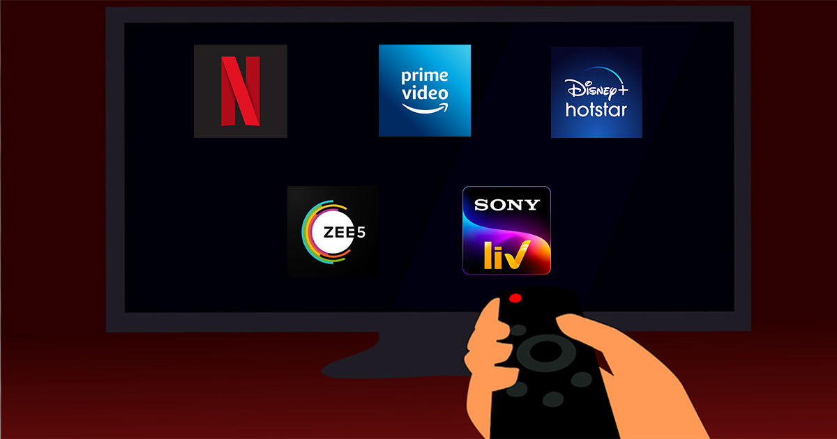
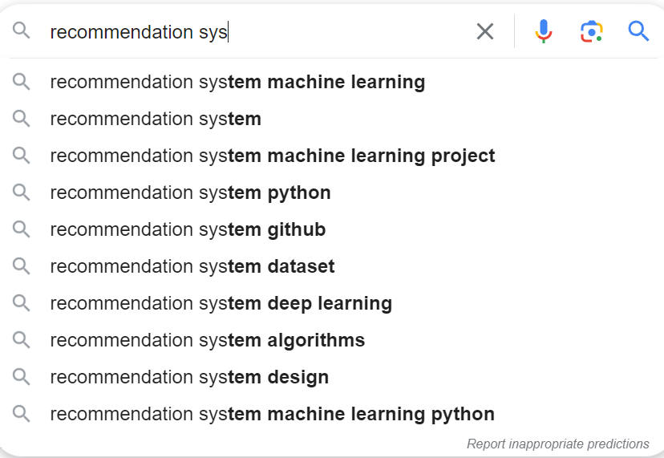
Recommendation systems

Slide 2
P-279 Book Recommendation ai variant
GROUP 4
-Avinash Vashisht

Slide 3
content
What is recommendation system ?
Applications?
Project Objective
Project Milestone
EDA
Data Cleaning
Modeling and Evaluation
Fetching Recommendations

Slide 4
What is a Recommender System ?
A recommender system is a system that is used to make prediction about the user preference
Recommender systems are trained to understand the preferences, previous decisions, and characteristics of people and products using data gathered about their interactions.

Slide 5

APPLICATIONS

Slide 6
APPLICATIONS
Movie recommendation in Netflix
Related products recommendation in Amazon
Web page ranking in Google
Friends recommendation in social networks eg. Facebook
News content recommendation in Yahoo News
Priorities Inbox and Spam mail filtering
Computational advertising in Yahoo
Online dating Sites

Slide 7
WHY?
To push content
More user engagement
To improve user ‘s experience
Providing user aid
Auto completion
Auto correction
Resource Friendly
Product Promotion

Slide 8
Business Objective
Generate the features from the dataset and use them to recommend the books accordingly to the users.

Slide 9
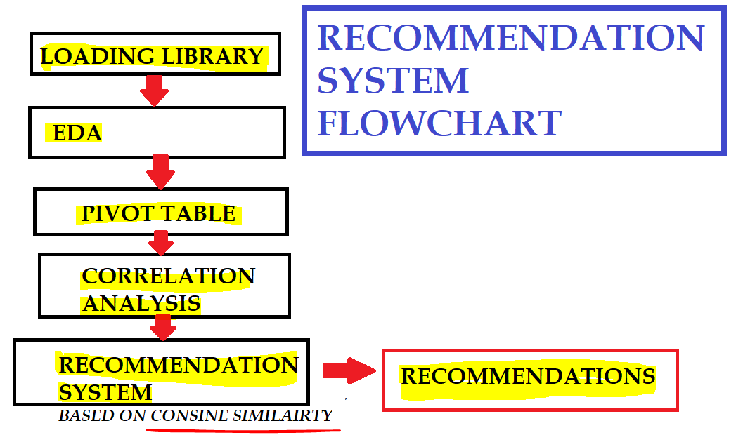

Slide 10
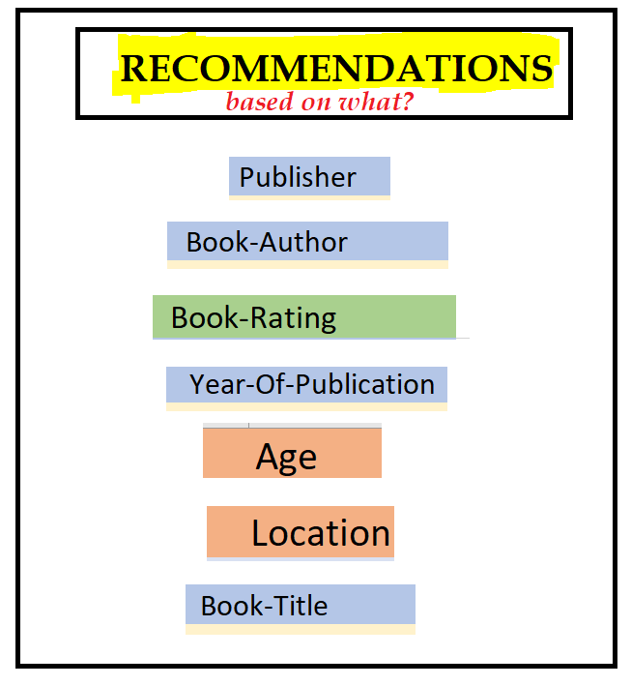

Slide 11
PROJECT MILESTONES
WEEK 1 : EDA
WEEK 2 : DATA WRANGLING
WEEK 3 : MODELING
WEEK 4 : DEPLOYMENT

Slide 12


Slide 13
DATASET ANALYSIS
BOOKS DATASET | USER DATASET | RATINGS DATASET
●ISBN (unique for each book) ●Book-Title ●Book-Author ●Year-Of-Publication ●Publisher ●Image-URL-S ●Image-URL-M ●Image-URL-L ●Shape of Dataset - (271360, 8) | ●User-ID (unique for each user) ●Location (contains city, state and country separated by commas) ●Age Shape of Dataset - (278858, 3) | ●User-ID ●ISBN ●Book-Rating ●Shape of Dataset -(1149780, 3)

Slide 14
DATA CLEANING
BOOKS DATASET | USER DATASET | RATINGS DATASET
● only 3 missing values ● dropping | ● Age – 40% missing values ●Outliers in Age column ●Age has positive Skewness (right tail) so we can use median to fill Nan values | ●most of ratings filled with zero ●Book-Rating – 65% missing values

Slide 15
Data Cleaning cont..
Number of Unique Book Authors are 102023
Number of Unique Books are 242135
user unique geolocation : 57339
Age : so many missing values
measures taken for Age Attribute : Median

Slide 16
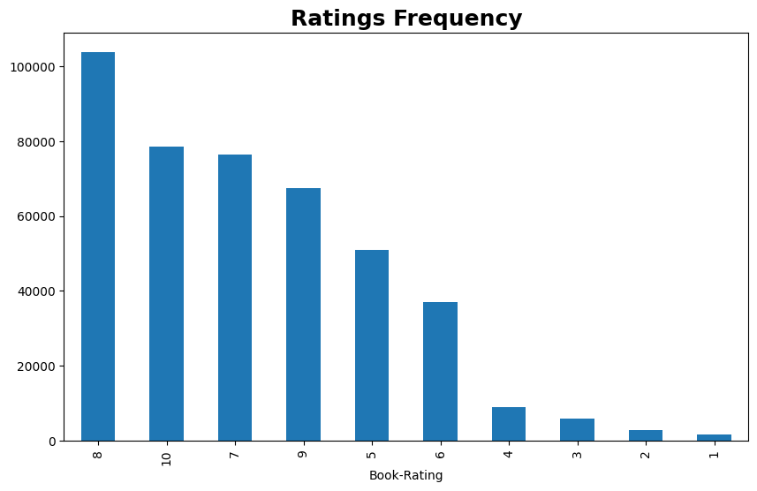
Observations from Ratings DATASET (Books Ratings)

Slide 17
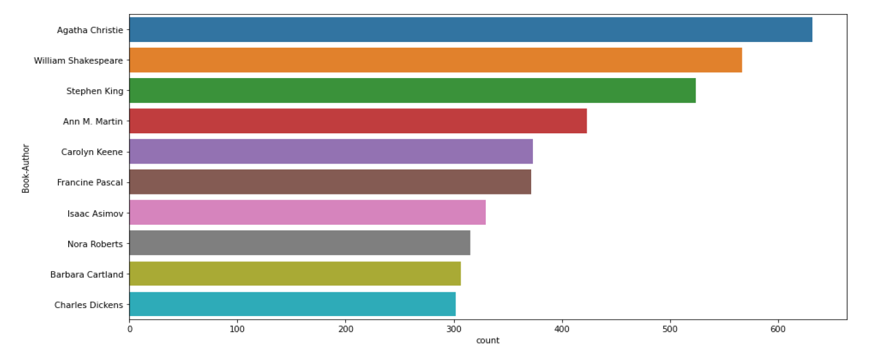
Observations from Book dataset (Authors)

Slide 18
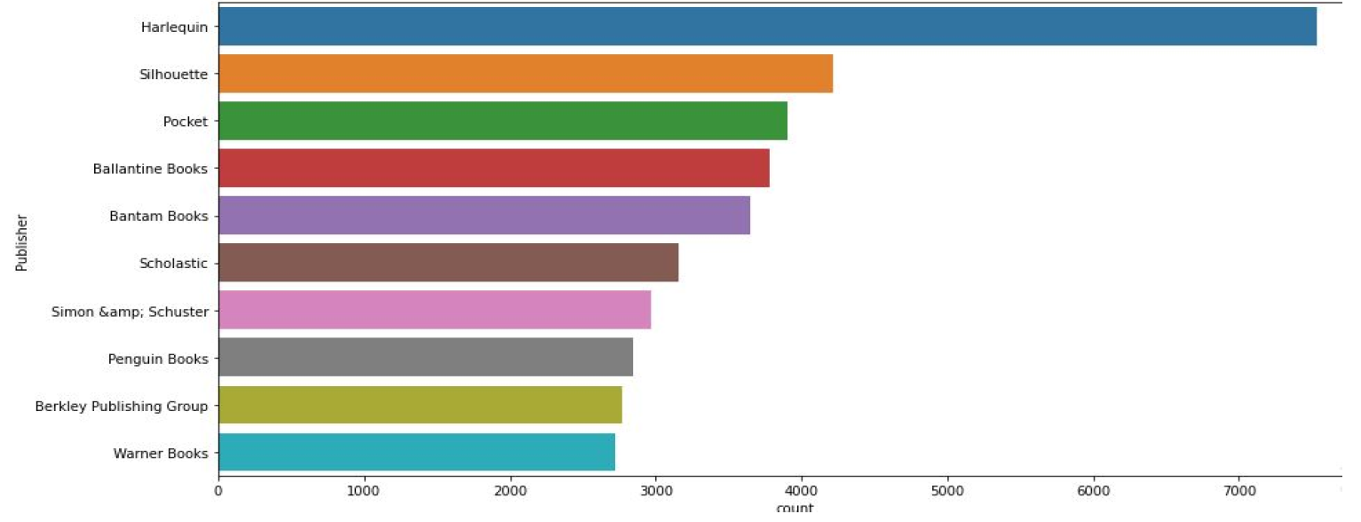
Observations from Book DATASET (Publishers)

Slide 19
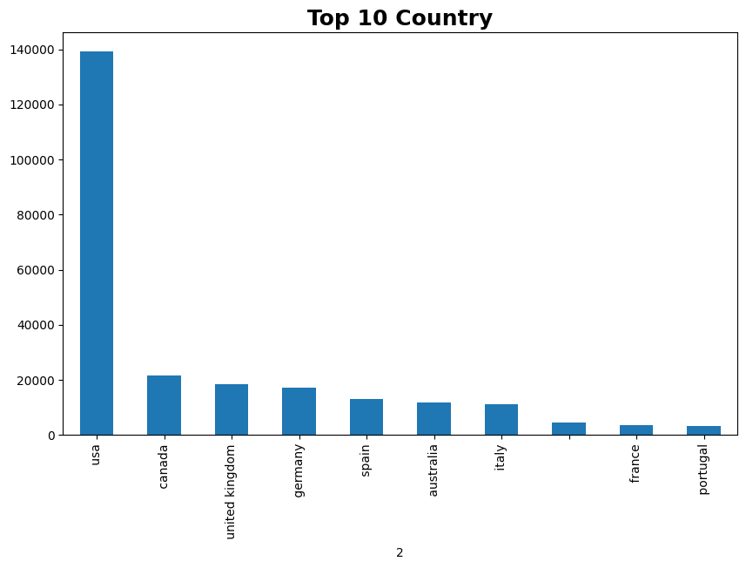

Slide 20
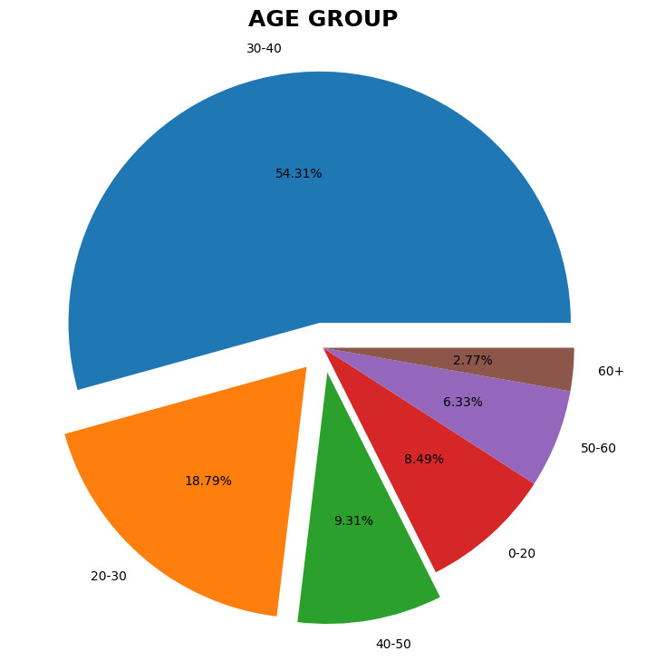
Most user of age group 30-40
More than 50 %
2nd major Gorup is 20-30
20-40 age group takes upto 70%

Slide 21
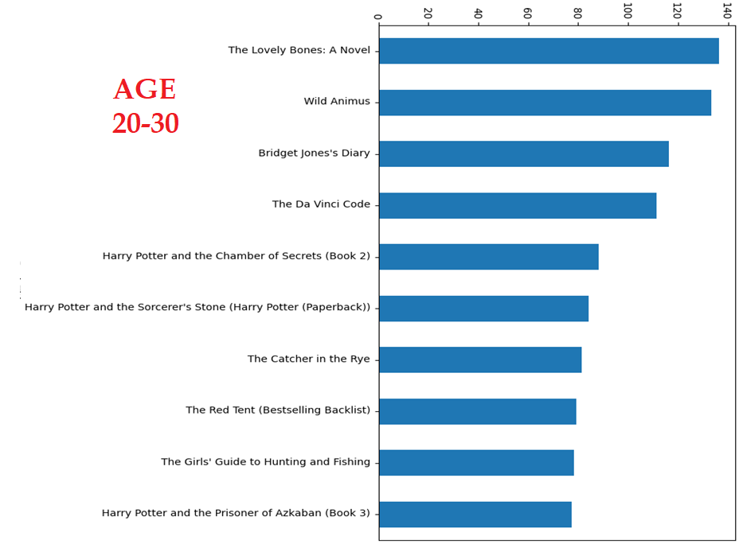

Slide 22
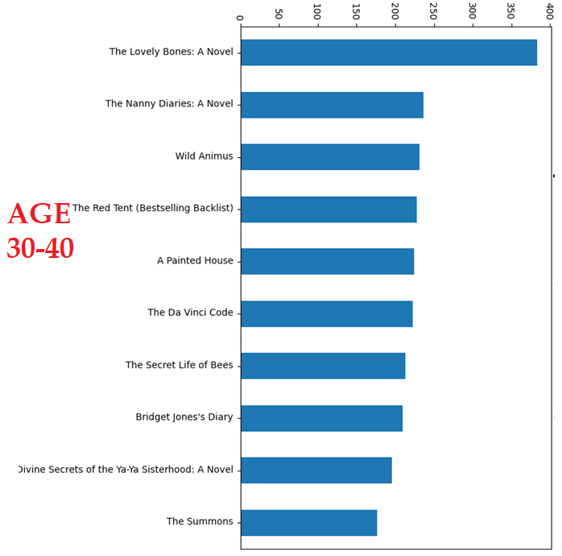

Slide 23
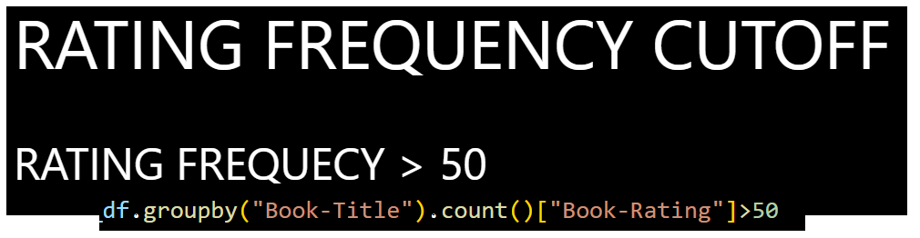
MEASURE FOR SPARSITY

Slide 24
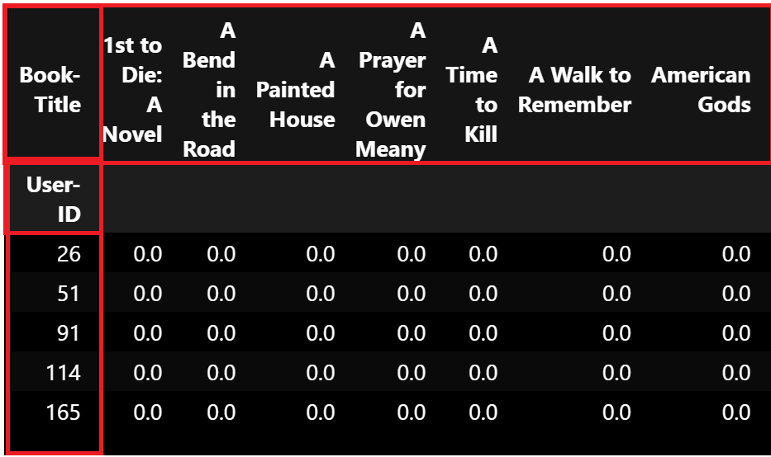
UTILITY MATRIX

Slide 25
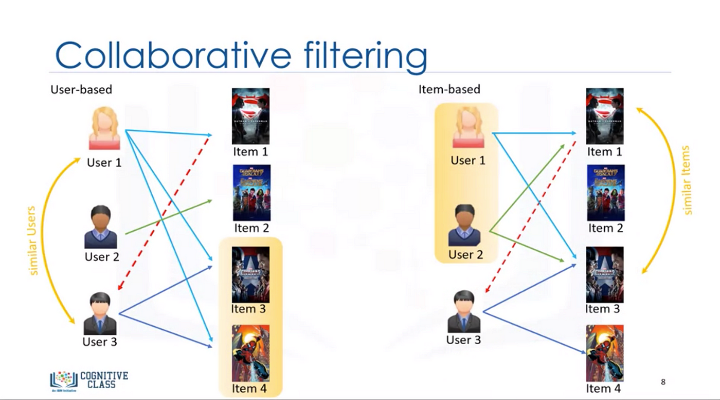

Slide 26
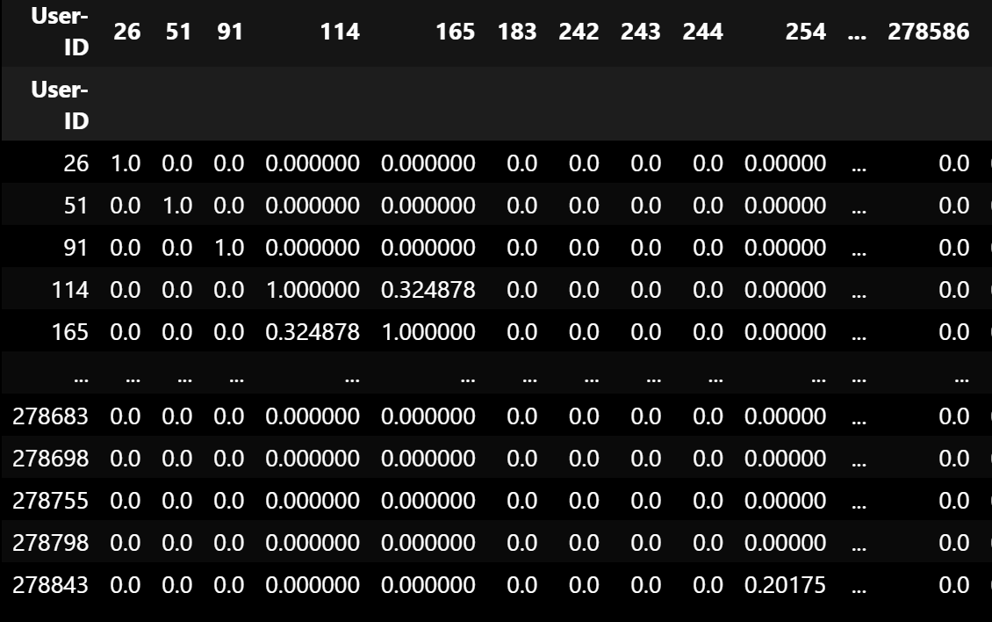
User-User-Based Collaborative Filtering

Slide 27
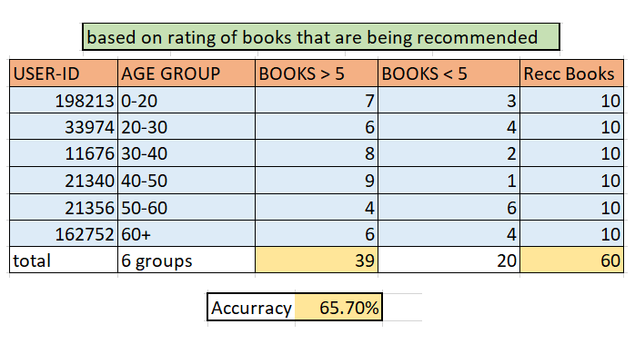
USER-USER EVALUATION

Slide 28
ITEM-ITEM-Based Collaborative Filtering

Slide 29
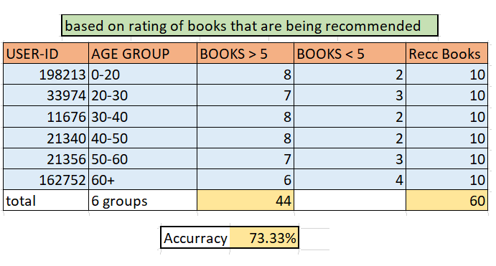
ITEM-ITEM EVALUATION

Slide 30


Slide 31
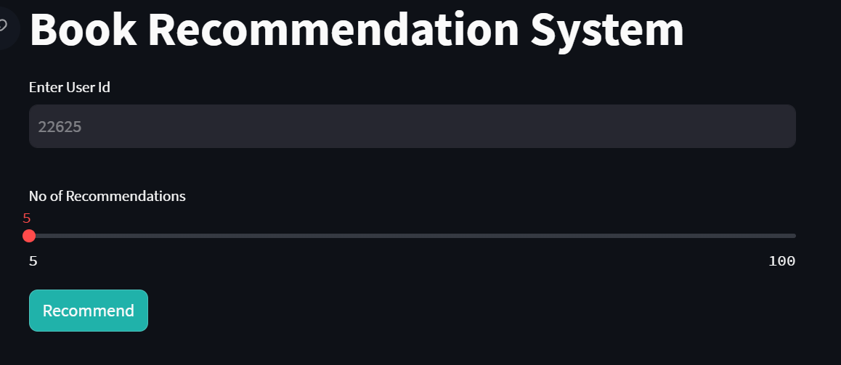
FETCHING RECOMMENDATIONS

Slide 32

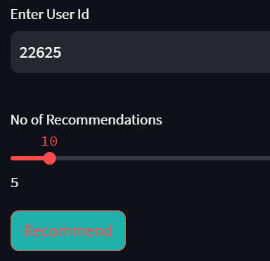

Slide 33
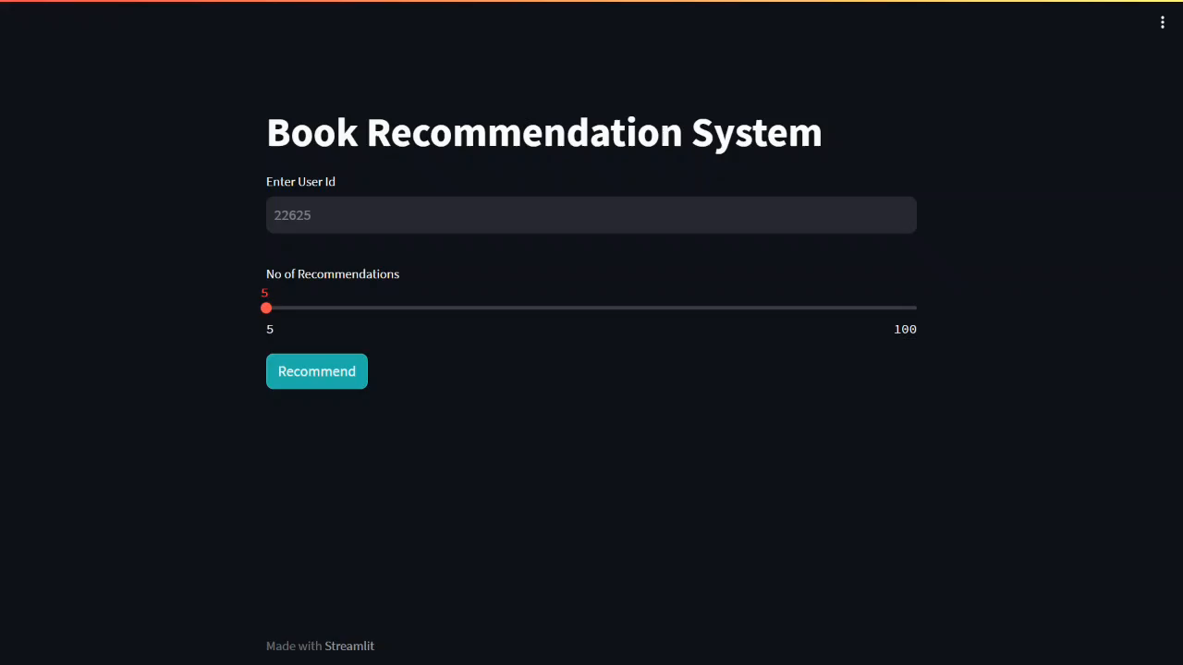
DEMo

Slide 34
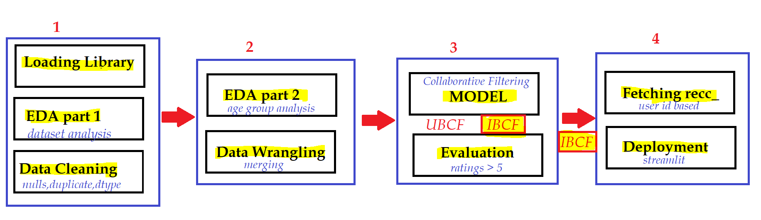
conclusion

Slide 35
Challenges
data cleaning was a major challenge in features like Location
missing value , outlier treatment was challenging as well
handling of sparsity was a major challenge
metric for evaluation

Slide 36
Future Scope
Given more information regarding the books dataset, namely features like Genre, Summary etc, we could implement a content filtering based recommendation
explore various clustering approaches wrt age groups and ratings
Predicting ratings

Slide 37


